Slide 1

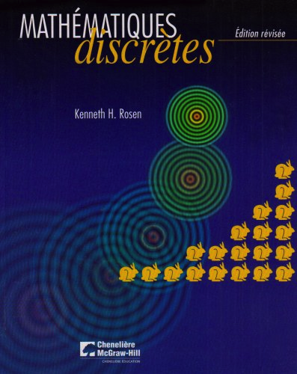
Books

Slide 2

Books

Slide 3
Table of contents
*Logic
Sets and functions
*Counting
*Advanced counting, recurrence relations
Relations
*Graphs
Trees
?Dynamic programming
?Markov chains

Slide 4
The Foundations: Logic and Proofs
Chapter 1, Part I: Propositional Logic
Rosen, “Discrete mathematics and its applications”
With Question/Answer Animations

Slide 5
Chapter Summary
Propositional Logic
The Language of Propositions
Applications
Logical Equivalences
Predicate Logic
The Language of Quantifiers
Logical Equivalences
Nested Quantifiers
Proofs
Rules of Inference
Proof Methods
Proof Strategy

Slide 6
Propositional Logic Summary
The Language of Propositions
Connectives
Truth Values
Truth Tables
Applications
Translating English Sentences
System Specifications
Logic Puzzles
Logic Circuits
Logical Equivalences
Important Equivalences
Showing Equivalence
Satisfiability

Slide 7
Propositional Logic
Section 1.1

Slide 8
Section Summary
Propositions
Connectives
Negation
Conjunction
Disjunction
Implication; contrapositive, inverse, converse
Biconditional
Truth Tables

Slide 9
Propositions
A proposition is a declarative sentence that is either true or false.
Examples of propositions:
The Moon is made of green cheese.
Trenton is the capital of New Jersey.
Toronto is the capital of Canada.
1 + 0 = 1
0 + 0 = 2
Examples that are not propositions.
Sit down!
What time is it?
x + 1 = 2
x + y = z

Slide 10
Propositional Logic
Constructing Propositions
Propositional variables: p, q, r, s, …
The proposition that is always true is denoted by T and the proposition that is always false is denoted by F.
Compound Propositions; constructed from logical connectives and other propositions
Negation ¬
Conjunction ∧
Disjunction ∨
Implication →
Biconditional/equivalence operator ↔

Slide 11
Compound Propositions: Negation
The negation of a proposition p is denoted by ¬p and has this truth table:
Example: If p denotes “The earth is round.”, then ¬p denotes “It is not the case that the earth is round,” or more simply “The earth is not round.”
p | ¬p
T | F
F | T

Slide 12
Conjunction
The conjunction of propositions p and q is denoted by p ∧ q and has this truth table:
Example: If p denotes “I am at home.” and q denotes “It is raining.” then p ∧q denotes “I am at home and it is raining.”
p | q | p ∧ q
T | T | T
T | F | F
F | T | F
F | F | F

Slide 13
Disjunction
The disjunction of propositions p and q is denoted by p ∨q and has this truth table:
Example: If p denotes “I am at home.” and q denotes “It is raining.” then p ∨q denotes “I am at home or it is raining.”
p | q | p ∨q
T | T | T
T | F | T
F | T | T
F | F | F

Slide 14
The Connective Or in English
In English “or” has two distinct meanings.
“Inclusive Or” - In the sentence “Students who have taken CS202 or Math120 may take this class,” we assume that students need to have taken one of the prerequisites, but may have taken both. This is the meaning of disjunction. For p ∨q to be true, either one or both of p and q must be true.
“Exclusive Or” - When reading the sentence “Soup or salad comes with this entrée,” we do not expect to be able to get both soup and salad. This is the meaning of Exclusive Or (Xor). In p ⊕ q , one of p and q must be true, but not both. The truth table for ⊕ is:
p | q | p ⊕q
T | T | F
T | F | T
F | T | T
F | F | F

Slide 15
Implication
If p and q are propositions, then p →q is a conditional statement or implication which is read as “if p, then q ” and has this truth table:
Example: If p denotes “I am at home.” and q denotes “It is raining.” then p →q denotes “If I am at home then it is raining.”
In p →q , p is the hypothesis (antecedent or premise) and q is the conclusion (or consequence, conclusion).
p | q | p →q
T | T | T
T | F | F
F | T | T
F | F | T

Slide 16
Understanding Implication
In p →q there does not need to be any connection between the antecedent or the consequent. The “meaning” of p →q depends only on the truth values of p and q.
These implications are perfectly fine, but would not be used in ordinary English.
“If the moon is made of green cheese, then I have more money than Bill Gates. ”
“If the moon is made of green cheese then I’m on welfare.”
“If 1 + 1 = 3, then your grandma wears combat boots.”

Slide 17
Understanding Implication (cont)
One way to view the logical conditional is to think of an obligation or contract.
“If I am elected, then I will lower taxes.”
“If you get 100% on the final, then you will get an A.”
If the politician is elected and does not lower taxes, then the voters can say that he or she has broken the campaign pledge. Something similar holds for the professor. This corresponds to the case where p is true and q is false.

Slide 18
Different Ways of Expressing p →q
if p, then q p implies q
if p, q p only if q
q unless ¬p q when p
q if p p is sufficient for q
q whenever p q is necessary when p
q follows from p
a necessary condition when p is true is q
a sufficient condition for q is p

Slide 19
Necessary and sufficient
p →q is true can be interpreted from set theory: {universes: p is true} ⊆ {universes: q is true}
q is necessary for p to be true (but not sufficient)
p is sufficient for q to be true
p | q | p →q
T | T | T
F | T | T
F | F | T
U
p →q is true
p is true
q is true
r is true

Slide 20
Necessary and sufficient
For instance,
If the gift is a car (p) then the gift is a vehicle (q)
To be a vehicle (q) is necessary in order to be a car (p)
To be a car (p) is sufficient to be a vehicle (q)
The gift is a vehicle (q) if it is a car (p)
The gift is a car (p) only if it is a vehicle (q)
–> if and only if

Slide 21
Converse, Contrapositive, and Inverse
From p →q we can form new conditional statements .
q →p is the converse of p →q
¬q → ¬p is the contrapositive of p →q
¬p → ¬q is the inverse of p →q
Example: Find the converse, inverse, and contrapositive of “Raining is a sufficient condition for me not going to town.”
Solution:
converse: If I do not go to town, then it is raining.
inverse: If it is not raining, then I will go to town.
contrapositive: If I go to town, then it is not raining.

Slide 22
Biconditional or equivalence
If p and q are propositions, then we can form the biconditional (or equivalence) proposition p ↔q , read as “p if and only if q .”
The biconditional p ↔q denotes the proposition with this truth table:
If p denotes “I am at home.” and q denotes “It is raining.” then p ↔q denotes “I am at home if and only if it is raining.”
p | q | p ↔q
T | T | T
T | F | F
F | T | F
F | F | T

Slide 23
Expressing the Biconditional
Some alternative ways “p if and only if q” is expressed in English:
p is necessary and sufficient for q
if p then q , and conversely
p iff q

Slide 24
Compound Propositions
We can build more complicated compound propositions, logical formula or logical expressions:
Atomic propositions are formula
If R is a formula then (¬R) is a formula
If R and S are formula then (R ∨S), (R ∧ S), (R → S), (R ↔S) all are formula

Slide 25
Truth Tables For Compound Propositions
Construction of a truth table:
Rows
Need a row for every possible combination of values for the atomic propositions. It enumerates all the possible universes.
Columns
Need a column for the compound proposition (usually at far right)
Need a column for the truth value of each expression that occurs in the compound proposition as it is built up.
This includes the atomic propositions

Slide 26
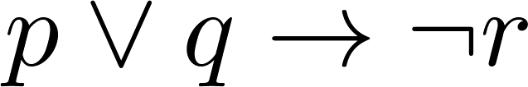
Example Truth Table
Construct a truth table for
p | q | r | ¬r | p ∨ q | p ∨ q → ¬r
T | T | T | F | T | F
T | T | F | T | T | T
T | F | T | F | T | F
T | F | F | T | T | T
F | T | T | F | T | F
F | T | F | T | T | T
F | F | T | F | F | T
F | F | F | T | F | T

Slide 27
Equivalent Propositions
Two (compound) propositions are logically equivalent if they always (in all universes) have the same truth value.
Example: Show using a truth table that the conditional is equivalent to the contrapositive.
Solution:
p | q | ¬ p | ¬ q | p →q | ¬q → ¬ p
T | T | F | F | T | T
T | F | F | T | F | F
F | T | T | F | T | T
F | F | T | T | T | T

Slide 28
Using a Truth Table to Show Non-Equivalence
Example: Show using truth tables that neither the converse nor the inverse of an implication are logically equivalent to the implication.
Solution:
p | q | ¬ p | ¬ q | p →q | ¬ p →¬ q | q → p
T | T | F | F | T | T | T
T | F | F | T | F | T | T
F | T | T | F | T | F | F
F | F | T | T | T | T | T

Slide 29
Problem
How many rows are there in a truth table with n propositional variables?
Solution: 2^{n}
Note that this means that with n propositional variables, we can construct 2^{n} distinct (i.e., not equivalent) propositions.

Slide 30
Precedence of Logical Operators
Operator | Precedence
¬ | 1
∧ ∨ | 2 3
→ ↔ | 4 5
p ∨q → ¬r is the same as (p ∨q) → ¬r
If the intended meaning is p ∨(q → ¬r )
then parentheses must be used.

Slide 31
Applications of Propositional Logic
Section 1.2

Slide 32
Applications of Propositional Logic: Summary
Translating English to Propositional Logic
System Specifications
Boolean Searching
Logic Puzzles
Logic Circuits
AI Diagnosis Method (Optional)

Slide 33
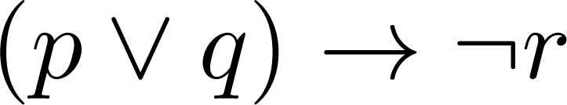
Translating English Sentences
Steps to convert an English sentence to a statement in propositional logic
Identify atomic propositions and represent using propositional variables.
Determine appropriate logical connectives
“If I go to Harry’s or to the country, then I will not go for shopping.”
p: I go to Harry’s
q: I go to the country.
r: I will go shopping.
If p or q then not r.

Slide 34
Example
Problem: Translate the following sentence into propositional logic:
“You can access the Internet from campus only if you are a computer science major or you are not a freshman.”
One Solution: Let a, c, and f represent respectively “You can access the internet from campus,” “You are a computer science major,” and “You are a freshman.”
a → (c ∨ ¬f )

Slide 35
System Specifications
System and Software engineers take requirements in English and express them in a precise specification language based on logic.
Example: Express in propositional logic:
“The automated reply cannot be sent when the file system is full”
Solution: One possible solution: Let p denote “The automated reply can be sent” and q denote “The file system is full.”
q → ¬p

Slide 36
Consistent System Specifications
Definition: A set of propositions is consistent (cohérent) if it is possible to assign truth values to the proposition variables so that each proposition is true.
In other words, there exists at least one universe where all the propositions are true.
Exercise: Are these specifications consistent?
“The diagnostic message is stored in the buffer or it is retransmitted.”
“The diagnostic message is not stored in the buffer.”
“If the diagnostic message is stored in the buffer, then it is retransmitted.”
Solution: Let p denote “The diagnostic message is not stored in the buffer.” Let q denote “The diagnostic message is retransmitted” The specification can be written as: p ∨ q, p → q, ¬p. When p is false and q is true all three statements are true. So the specification is consistent.
What if “The diagnostic message is not retransmitted” is added.
Solution: Now we are adding ¬q and there is no satisfying assignment. So the specification is not consistent.

Slide 37
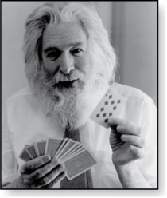
Logic Puzzles
Raymond Smullyan
(Born 1919)
An island has two kinds of inhabitants, knights, who always tell the truth, and knaves, who always lie.
You go to the island and meet A and B.
A says “B is a knight.”
B says “The two of us are of opposite types.”
Example: What are the types of A and B?
Solution: Let p and q be the statements that “A is a knight” and “B is a knight”, respectively. So, then ¬p represents the proposition that “A is a knave” and ¬q that “B is a knave”.
If A is a knight, then p is true. Since knights tell the truth, q must also be true. Then (p ∧ ¬q) ∨ (¬p ∧ q) would have to be true, but it is not. So, A is not a knight and therefore ¬p must be true.
If A is a knave, then B must not be a knight since knaves always lie. So, then both ¬p and ¬q hold since both are knaves.

Slide 38
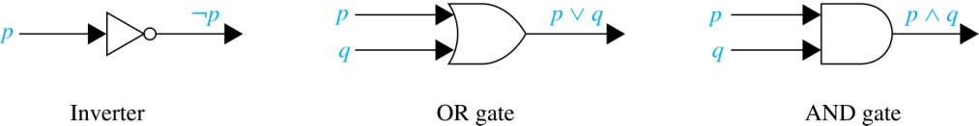
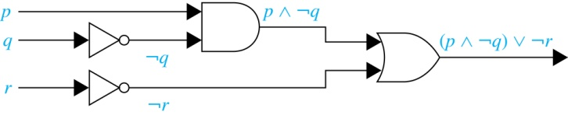
Logic Circuits (Studied in depth in Chapter 12)
Electronic circuits. Each input/output signal can be viewed as a 0 or 1.
0 represents False
1 represents True
Complicated circuits are constructed from three basic circuits called gates.
The inverter (NOT gate) takes an input bit and produces the negation of that bit.
The OR gate takes two input bits and produces the value equivalent to the disjunction of the two bits.
The AND gate takes two input bits and produces the value equivalent to the conjunction of the two bits.
More complicated digital circuits can be constructed by combining these basic circuits to produce the desired output given the input signals by building a circuit for each piece of the output expression and then combining them. For example:

Slide 39
Diagnosis of Faults in an Electrical System (Optional)
AI Example (from Artificial Intelligence: Foundations of Computational Agents by David Poole and Alan Mackworth, 2010)
Need to represent in propositional logic the features of a piece of machinery or circuitry that are required for the operation to produce observable features. This is called the Knowledge Base (KB).
We also have observations representing the features that the system is exhibiting now.

Slide 40
Electrical System Diagram (optional)
Outside Power
s1
cb1
Have lights (l1, l2), wires (w0, w1, w2, w3, w4), switches (s1, s2, s3), and circuit breakers (cb1)
w1
w3
w2
s2
The next page gives the knowledge base describing the circuit and the current observations.
s3
w0
w4
l1
l2

Slide 41
Representing the Electrical System in Propositional Logic
We need to represent our common-sense understanding of how the electrical system works in propositional logic.
For example: “l1 is lit only when l1 is a light and if l1 is receiving current.”
lit_l1 → light_l1 ∧ live_l1 ∧ ok_l1
Also: “w0 has current only when w1 has current, and switch s2 is in the up position, and s2 is not broken.”
live_w0 → live_w1 ∧ up_s2 ∧ ok_s2
This task of representing a piece of our common-sense world in logic is a common one in logic-based AI.

Slide 42
Knowledge Base (opt)
live_outside
light_l1
light_l2
live_l1 → live_w0
live_w0 → live_w1 ∧ up_s2 ∧ ok_s2
live_w0 → live_w2 ∧ down_s2 ∧ ok_s2
live_w1 → live_w3 ∧ up_s1 ∧ ok_s1
live_w2 → live_w3 ∧ down_s1 ∧ ok_s1
live_l2 → live_w4
live_w4 → live_w3 ∧ up_s3 ∧ ok_s3
live_w3 → live_outside ∧ ok_cb1
lit_l1 → light_l1 ∧ live_l1 ∧ ok_l1
lit_l2 → light_l2 ∧ live_l2 ∧ ok_l2
We have outside power.
Both l1 and l2 are lights.
If s2 is ok and s2 is in a down position and w2 has current, then w0 has current.

Slide 43
Observations (opt)
Observations or facts need to be added to the KB
Both Switches up
up_s1
up_s2
Both lights are dark
¬lit_l1
¬lit_l2

Slide 44
Diagnosis (opt)
We assume that the components are working ok, unless we are forced to assume otherwise. These atoms are called assumables.
The assumables (ok_cb1, ok_s1, ok_s2, ok_s3, ok_l1, ok_l2) represent the assumption that we assume that the switches, lights, and circuit breakers are ok.
If the system is working correctly (all assumables are true), the observations and the knowledge base are consistent (i.e., satisfiable).
The augmented knowledge base is clearly not consistent if the assumables are all true. The switches are both up, but the lights are not lit. Some of the assumables must then be false. This is the basis for the method to diagnose possible faults in the system.
A diagnosis is a minimal set of assumables which must be false to explain the observations of the system.

Slide 45
Diagnostic Results (opt)
See Artificial Intelligence: Foundations of Computational Agents (by David Poole and Alan Mackworth, 2010) for details on this problem and how the method of consistency based diagnosis can determine possible diagnoses for the electrical system.
The approach yields 7 possible faults in the system. At least one of these must hold:
Circuit Breaker 1 is not ok.
Both Switch 1 and Switch 2 are not ok.
Both Switch 1 and Light 2 are not ok.
Both Switch 2 and Switch 3 are not ok.
Both Switch 2 and Light 2 are not ok.
Both Light 1 and Switch 3 are not ok.
Both Light 1 and Light 2 are not ok.

Slide 46
Propositional Equivalences
Section 1.3

Slide 47
Section Summary
Tautologies, Contradictions, and Contingencies.
Logical Equivalence
Important Logical Equivalences
Showing Logical Equivalence
Normal Forms (optional, covered in exercises in text)
Disjunctive Normal Form
Conjunctive Normal Form
Propositional Satisfiability
Sudoku Example

Slide 48
Tautologies, Contradictions, and Contingencies
A tautology is a proposition which is always true.
Example: p ∨¬p
A contradiction is a proposition which is always false.
Example: p ∧¬p
A contingency is a proposition which is neither a tautology nor a contradiction, such as p
p | ¬p | p ∨¬p | p ∧¬p
T | F | T | F
F | T | T | F

Slide 49
Logically Equivalent
Two compound propositions p and q are logically equivalent if and only if p ↔ q is a tautology.
We can write this as p ⇔ q or as p ≡ q where p and q are compound propositions.
Two compound propositions p and q are equivalent if and only if the columns in a truth table giving their truth values agree.
This truth table shows that ¬p ∨ q is logically equivalent to p → q.
p | q | ¬p | ¬p ∨ q | p → q
T | T | F | T | T
T | F | F | F | F
F | T | T | T | T
F | F | T | T | T

Slide 50
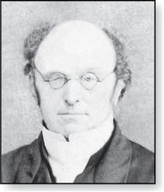
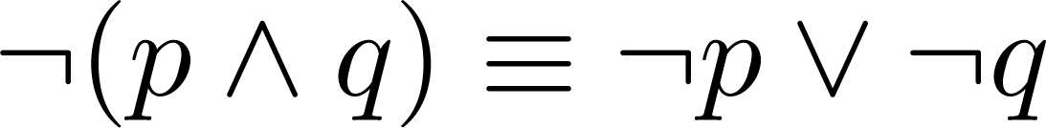
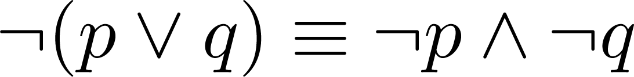
De Morgan’s Laws
Augustus De Morgan
1806-1871
Distribution of the negation operator
This truth table shows that De Morgan’s Second Law holds.
p | q | ¬p | ¬q | (p ∨ q) | ¬(p ∨ q) | ¬p ∧ ¬q
T | T | F | F | T | F | F
T | F | F | T | T | F | F
F | T | T | F | T | F | F
F | F | T | T | F | T | T

Slide 51
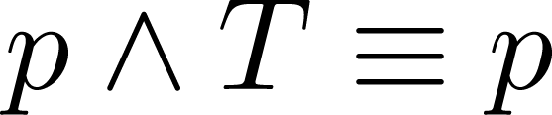
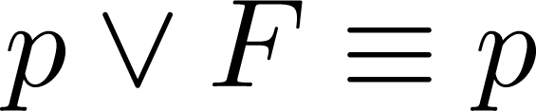
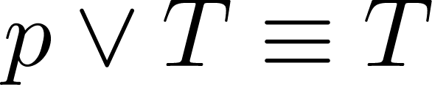
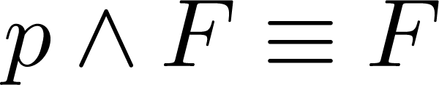
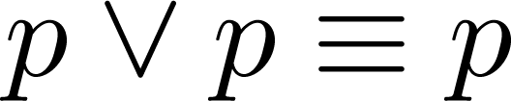
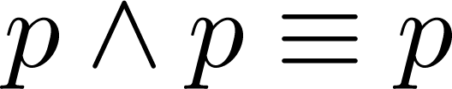
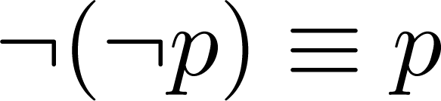
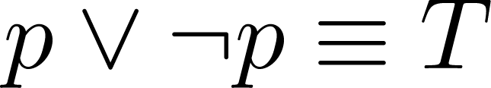
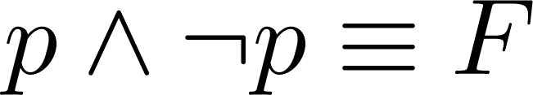
Key Logical Equivalences
Identity laws: ,
Domination laws: ,
Idempotent laws: ,
Double Negation law:
Negation laws: ,

Slide 52
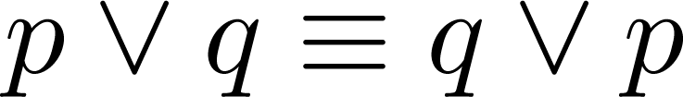
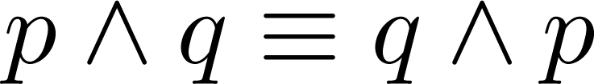
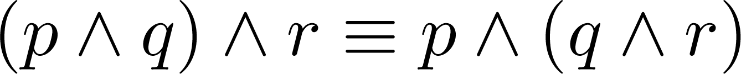
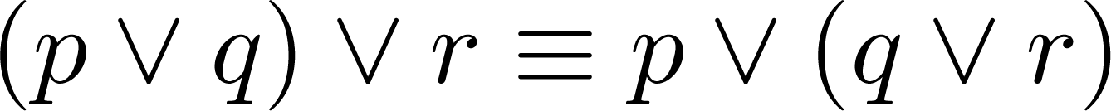
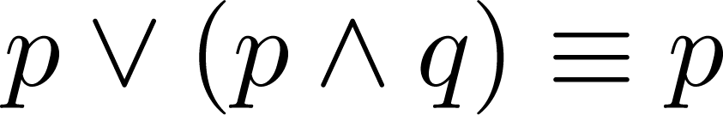
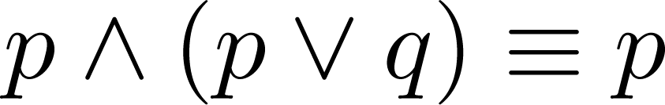
Key Logical Equivalences (cont)
Commutative laws: ,
Associative laws:
Distributive laws:
Absorption laws:

Slide 53
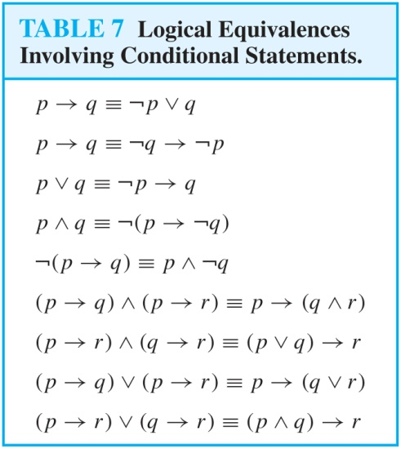
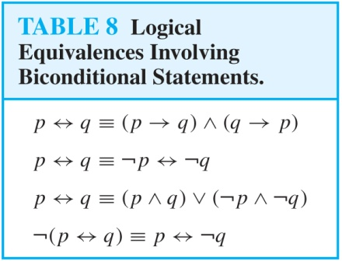
More Logical Equivalences

Slide 54



Constructing New Logical Equivalences
We can show that two expressions are logically equivalent by developing a series of logically equivalent statements.
To prove that we produce a series of equivalences beginning with A and ending with B.
Keep in mind that whenever a proposition (represented by a propositional variable) occurs in the equivalences listed earlier, it may be replaced by an arbitrarily complex compound proposition.

Slide 55
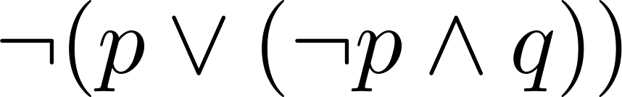
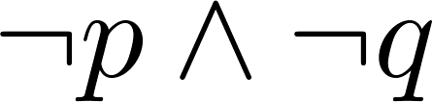
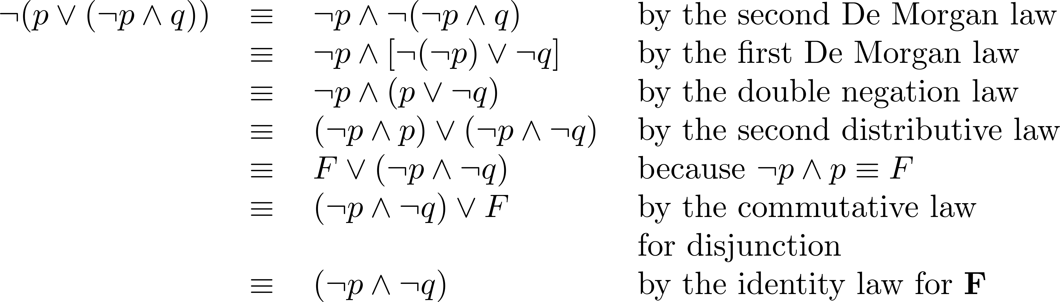
Equivalence Proofs
Example: Show that
is logically equivalent to
Solution:

Slide 56
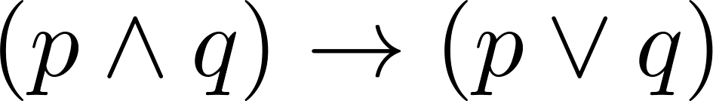
Equivalence Proofs
Example: Show that
is a tautology.
Solution:

Slide 57
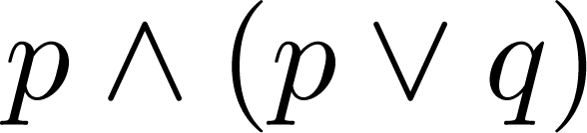
Disjunctive Normal Form
A propositional formula is in disjunctive normal form if it consists of a disjunction of (1, … , n) disjuncts where each disjunct consists of a conjunction of (1, …, m) atomic formula or the negation of an atomic formula.
Yes
No
Disjunctive Normal Form is important in many applications, such as for the circuit design methods discussed in Chapter 12.

Slide 58
Disjunctive Normal Form
Show that every compound proposition can be put in disjunctive normal form.
Solution: Construct the truth table for the proposition.
Then a logically equivalent proposition is the disjunction with n disjuncts, where n is the number of rows for which the formula evaluates to T (number of universes in which the proposition is T).
Each disjunct is composed of m conjuncts where m is the number of distinct atomic propositional variables. Each conjunct includes the positive form of the propositional variable if the variable is assigned T in that row and the negated form if the variable is assigned F in that row.

Slide 59
Disjunctive Normal Form
Show that every compound proposition can be put in disjunctive normal form (follow-up).
This proposition is in disjunctive normal form because
By construction, each disjunct corresponds exactly to one and only one universe which has a true value (bijection) and is T in this universe. For all other universes, it is false
Thus, the disjunctive normal form (the disjunction of all the disjuncts – a standard OR)
is automatically true in each universe for which the true table is true and
is automatically false in each universe for which the true table is false: all disjuncts are false.
Therefore, it is logically equivalent to the original proposition.

Slide 60
Disjunctive Normal Form
Example: Find the Disjunctive Normal Form (DNF) of
(p ∨ q) → ¬r
Solution: This proposition is true when r is false or when both p and q are false.
(¬p ∧ ¬q) ∨ ¬r

Slide 61
Disjunctive Normal Form
Here is an illustration
p | q | r | ¬r | p ∨ q | p ∨ q → ¬r
T | T | T | F | T | F
T | T | F | T | T | T
T | F | T | F | T | F
T | F | F | T | T | T
F | T | T | F | T | F
F | T | F | T | T | T
F | F | T | F | F | T
F | F | F | T | F | T

Slide 62
Conjunctive Normal Form
A compound proposition is in Conjunctive Normal Form (CNF) if it is a conjunction of disjunctions.
Every proposition can be put in an equivalent CNF.
Conjunctive Normal Form (CNF) can be obtained by eliminating implications, moving negation inwards and using the distributive and associative laws.
Important in resolution theorem proving used in artificial Intelligence (AI).
A compound proposition can be put in conjunctive normal form through repeated application of the logical equivalences covered earlier.

Slide 63
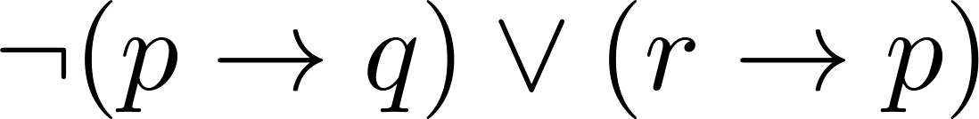
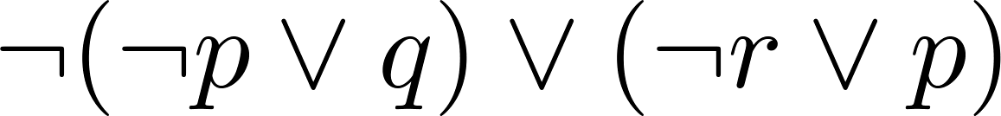
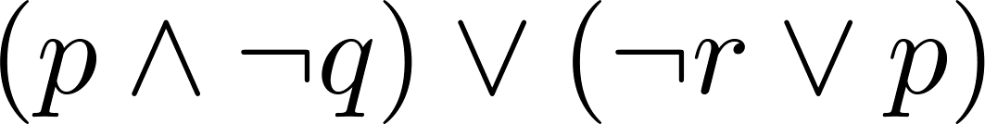
Conjunctive Normal Form
Example: Put the following into CNF:
Solution:
Eliminate implication signs:
Move negation inwards; eliminate double negation:
Convert to CNF using associative/distributive laws

Slide 64
Propositional Satisfiability
A compound proposition is satisfiable if there is an assignment of truth values to its variables that make it true.
When no such assignments exist, the compound proposition is unsatisfiable.
A compound proposition is unsatisfiable if and only if its negation is a tautology and the proposition is a contradiction.

Slide 65
Questions on Propositional Satisfiability
Example: Determine the satisfiability of the following compound propositions:
Solution: Satisfiable. Assign T to p, q, and r.
Solution: Satisfiable. Assign T to p and F to q.
Solution: Not satisfiable. Check each possible assignment of truth values to the propositional variables and none will make the proposition true.

Slide 66
Notation

Slide 67
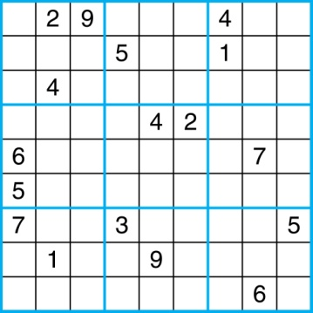
Sudoku
A Sudoku puzzle is represented by a 9×9 grid made up of nine 3×3 subgrids, known as blocks. Some of the 81 cells of the puzzle are assigned one of the numbers 1, 2, …, 9.
The puzzle is solved by assigning numbers to each blank cell so that every row, column and block contains each of the nine possible numbers.
Example

Slide 68
Encoding as a Satisfiability Problem
Let p(i,j,n) denote the proposition that is true when the number n is in the cell in the ith row and the jth column.
There are 9 × 9 × 9 = 729 such propositions.
In the sample puzzle p(5,1,6) is true, but p(5,j,6) is false for j = 2,3,…9

Slide 69
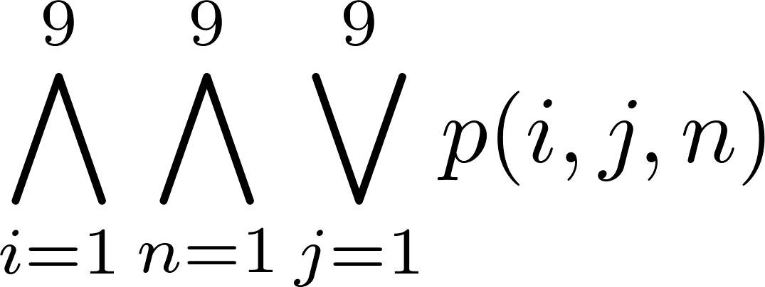
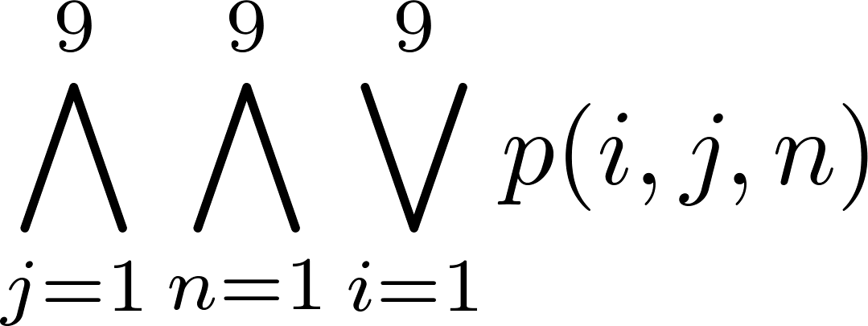
Encoding (cont)
For each cell with a given value, assert p(i,j,n), when the cell in row i and column j has the given value.
Assert that every row contains every number.
Assert that every column contains every number.

Slide 70
Solving Satisfiability Problems
To solve a Sudoku puzzle, we need to find an assignment of truth values to the 729 variables of the form p(i,j,n) that makes the conjunction of the assertions true. Those variables that are assigned T yield a solution to the puzzle.
A truth table can always be used to determine the satisfiability of a compound proposition. But this is too complex even for modern computers for large problems.
There has been much work on developing efficient methods for solving satisfiability problems as many practical problems can be translated into satisfiability problems.

